Slide 1
CSCI1540 Fundamental Computing with C++
Advanced Control Flow
Fall, 2019

Slide 2
Outline
Short-circuit evaluations
do-while loops
for loops
Nested loops
break and continue statements
switch … case

Slide 3
1. Short-Circuit Evaluations
Evaluation of expressions containing && and || stops as soon as the outcome (true or false) is known
expr1 && expr2
If expr1 evaluates to false, the evaluation of expr2 will not occur
expr1 || expr2
If expr1 evaluates to true, the evaluation of expr2 will not occur

Slide 4
Short-Circuit: Examples
1
2
3
4
5
6
7
8
9
10
11
12
13
14
int i = 0, j = 0;
bool b;
b = ((i == 0) && (++j == 1));
cout << b << " " << i << " " << j << endl; // Print 1 0 1
b = ((i == 1) && (++j == 1));
cout << b << " " << i << " " << j << endl; // Print 0 0 1
b = ((i == 1) || (++j == 2));
cout << b << " " << i << " " << j << endl; // Print 1 0 2
b = ((i == 0) || (++j == 3));
cout << b << " " << i << " " << j << endl; // Print 1 0 2
Be careful when using && and/or || in loops or selection statements!

Slide 5
2. do-while Statement: Syntax
do
statement;
while (expr);
next_statement;
statement
expr
true
false
next_statement
Similar to while
But statement is executed at least once because expr is evaluated at bottom

Slide 6
1
2
3
4
5
6
7
8
9
10
11
12
13
14
15
16
17
18
19
20
#include <iostream>
#include <climits>
using namespace std;
int main() {
int cnt = 0, max = INT_MIN, n, x;
cout << "How many numbers do you wish to enter? ";
cin >> n;
cout << "\nEnter " << n << " numbers:\n";
do {
cin >> x;
if (max < x)
max = x; // Record the current largest
cnt++;
} while (cnt < n);
cout << "\nMaximum value: " << max << endl;
return 0;
}
INT_MIN is the most –ve integer for type int
Must #include <climits> to use INT_MIN
INT_MIN is the most –ve integer of type int
Must #include <climits> to use INT_MIN
Example: find the largest number among N user inputs

Slide 7
Review: Counting Using while Loops
What are the three “must-have” in using a while loop to execute “statement” 10 times?
i = 0; // Initialization
while (i < 10) { // Stopping condition
statement;
i++; /* Increase/Decrease
of loop variable */
}

Slide 8
3. Counting Using for Loops
for (i = 0; i < 10; i++) {
statement;
}
i = 0
These two loops are logically equivalent
false
i < 10
true
i = 0;
while (i < 10) {
statement;
i++;
}
statement
i++

Slide 9
for Loop: Syntax
for (expr1; expr2; expr3)
statement;
next_statement;
expr1
Typical use of each expression:
expr1: initialization
expr2: condition (loop while expr2 is true)
expr3: increment/decrement
Must separate expr1, expr2, and expr3 using semicolon (;)
false
expr2
true
statement
expr3
next_statement

Slide 10
for Loop: Example
1
2
3
4
5
6
7
8
9
10
11
12
13
14
15
16
17
#include <iostream>
using namespace std;
int main() {
int count, i;
cout << "Count? ";
cin >> count;
for (i = 0; i < count; i++)
cout << count – i << endl;
cout << "Go!\n";
return 0;
}
Count? 5↵
5
4
3
2
1
Go!
Alternative:
for (i = count; i >= 1; i--)
cout << i << endl;
Example: counting downwards

Slide 11
for Loop: Counter Declaration
1
2
3
4
5
int i; // Declare loop variable before for loop
for (i = 0; i < 5; i++)
cout << i << endl;
i = 20; // i is still accessible outside for loop
1
2
3
4
5
6
// Declare loop variable inside for loop
for (int i = 0; i < 5; i++)
cout << i << endl;
// i is NOT accessible outside for loop
i = 100; // Compilation error!
The latter declaration is more convenient and helps localize the use of loop variable
However, you should be careful not to access the loop variable outside the loop

Slide 12
for Loop: Example
1
2
3
4
5
6
7
8
9
10
11
12
13
14
15
16
#include <iostream>
using namespace std;
int main() {
int n;
cout << "n ? ";
cin >> n;
for (int i = 1; i <= n; i += 2)
cout << i << " ";
cout << endl;
return 0;
}
Example: print all odd numbers from 1 to N
n ? 12↵
1 3 5 7 9 11

Slide 13
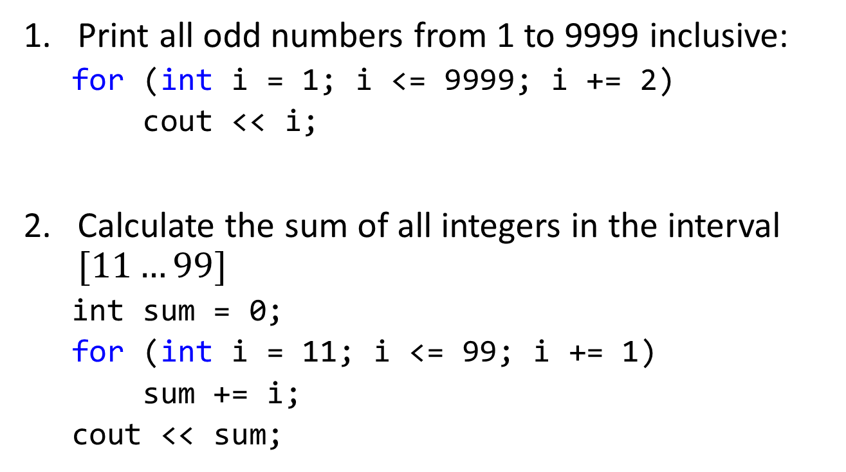
for Loop: Exercises
Print all odd numbers from 1 to 9999 inclusive:
for (int i = 1; i <= 9999; i += 2)
cout << i;
Calculate the sum of all integers in the interval $[11…99]$
int sum = 0;
for (int i = 11; i <= 99; i += 1)
sum += i;
cout << sum;

Slide 14
for Loop: Exercises
Print the series:
1 4 2 5 3 6 4 7 […] 96 99 97 100
for (int i = 1; i <= 97; i += 1){
cout << i << “ “;
cout << i+3 << “ “;
}

Slide 15
Empty Statement in for Loop
(Optional)
for (expr1; expr2; expr3)
statement;
next_statement;
Any of expr1, expr2, and expr3 can be omitted
; is still needed at the proper position
; is called the empty statement
Useful when a statement is needed syntactically but no action is required semantically

Slide 16
Examples
(Optional)
int i = 1;
int sum = 0;
for ( ; i <= 10; i++)
sum += i;
Infinite loop using for
Used as while loop
for (;;)
statement;
for (; condition;)
statement;

Slide 17
Comma Operator ,
(Optional)
expr1, expr2
Lowest precedence of all operators
Left-to-right associativity
Value of expr2 is taken as value of the whole expression
Useful for initializing more than one variables in a for loop
z = (x = 2, y = 3); // z gets 3
z = (3, 4); // z gets 4
for (i = 1, factorial = 1; i <= n; i++)
factorial *= i;

Slide 18
4. Nested Loops
i
j
1 1
1 2
1 3
1 4
2 1
2 2
2 3
2 4
3 1
3 2
3 3
3 4
i = 1
A loop inside another loop
E.g.:
A for loop is consider as only ONE statement
For each outer loop iteration, the inner loop iterates 4 times
i = 2
int i, j;
for (i = 1; i <= 3; i++)
for (j = 1; j <= 4; j++)
cout << i << " " << j << endl;
i = 3

Slide 19
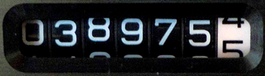
4. Nested Loops
Analogy: odometer in a vehicle
Left digits move less frequently
Right digits move more frequently
One digit rotates completely (0-0) while the one to its left iterates once only
while (…) {
…
for (…;…;…) {
…
do {
for (…;…;…)
…
…
} while (…);
}
}
Outer loops iterate “less frequently”
One loop finishes completely while its outer one iterates once only
Inner loops iterate “more frequently”

Slide 20
1
2
3
4
5
6
7
8
9
10
11
12
13
14
15
int row, column;
cout << "Row = ? ";
cin >> row;
cout << "Column = ? ";
cin >> column;
for (int i = 1; i <= row; i++) {
for (int j = 1; j <= column; j++)
cout << "*";
cout << endl;
}
Row = ? 3↵
Column = ? 5↵
*****
*****
*****
Example: Print a rectangle

Slide 21
1
2
3
4
5
6
7
8
9
10
11
12
13
14
15
16
int size;
cout << Size = ? ";
cin >> size;
for (int i = 1; i <= size; i++) {
for (int j = 1; j <= size - i; j++)
cout << " ";
for (int j = 1; j <= i; j++)
cout << "*";
cout << endl;
}
Size = ? 5↵
*
**
***
****
*****
Example: Print a triangle (Version 1)

Slide 22
1
2
3
4
5
6
7
8
9
10
11
12
13
14
15
16
int size;
cout << Size = ? ";
cin >> size;
for (int i = 1; i <= size; i++) {
for (int j = 1; j <= size; j++)
if (j <= size - i)
cout << " ";
else
cout << "*";
cout << endl;
}
Size = ? 5↵
*
**
***
****
*****
Example: Print a triangle (Version 2)

Slide 23
Nested Loop: Exercise
Write a code fragment that reads in the width and height of a rectangle and then prints a hollow rectangle of that dimension
Sample runs:
Width, height? 4 5↵
****
* *
* *
* *
****
Width, height? 9 6↵
*********
* *
* *
* *
* *
*********
Width, height? 8 8↵
********
* *
* *
* *
* *
* *
* *
********

Slide 24
1
2
3
4
5
6
7
8
9
10
11
12
13
14
15
16
17
18
19
20
int k, input;
bool isPrime;
do {
cin >> input;
isPrime = true;
} while (!isPrime);
Repeatedly read some user input
Example: Repeatedly read in an integer from user until a prime number is obtained

Slide 25
1
2
3
4
5
6
7
8
9
10
11
12
13
14
15
16
17
18
19
20
int k, input;
bool isPrime;
do {
cin >> input;
isPrime = true;
k = 2;
while (input % k != 0)
k++;
if (k < input) // A factor k is found
isPrime = false;
} while (!isPrime);
Find some factor for an input
Example: Repeatedly read in an integer from user until a prime number is obtained

Slide 26
1
2
3
4
5
6
7
8
9
10
11
12
13
14
15
16
17
18
19
20
int k, input;
bool isPrime;
do {
cin >> input;
isPrime = true;
k = 2;
while (input % k != 0)
k++;
if (k < input) // A factor k is found
isPrime = false;
if (isPrime)
cout << input << " is prime." << endl;
else
cout << input << " is not prime." << endl;
} while (!isPrime);
Input is prime if factor is found
Example: Repeatedly read in an integer from user until a prime number is obtained

Slide 27
1
2
3
4
5
6
7
8
9
10
11
12
13
14
15
16
17
18
19
20
int k, input;
bool isPrime;
do {
cin >> input;
isPrime = true;
if (input < 2) // -ve, 0, 1 cannot be prime
isPrime = false;
else {
k = 2;
while (input % k != 0)
k++;
if (k < input) // A factor k is found
isPrime = false;
}
if (isPrime)
cout << input << " is prime." << endl;
else
cout << input << " is not prime." << endl;
} while (!isPrime);
Handle some special cases
Example: Repeatedly read in an integer from user until a prime number is obtained

Slide 28
Nested Loops: Example
1
2
3
4
5
6
7
8
9
10
11
int cnt = 0, n = 7;
for (int i = 0; i <= n; i++)
for (int j = 0; j <= n; j++)
for (int k = 0; k <= n; k++)
if (i + j + k == n) {
cnt++;
cout << i << " " << j << " " << k << endl;
}
cout << "\nCount: " << cnt << endl;
Example:
Study and trace the above code fragment
What does it intend to do?

Slide 29
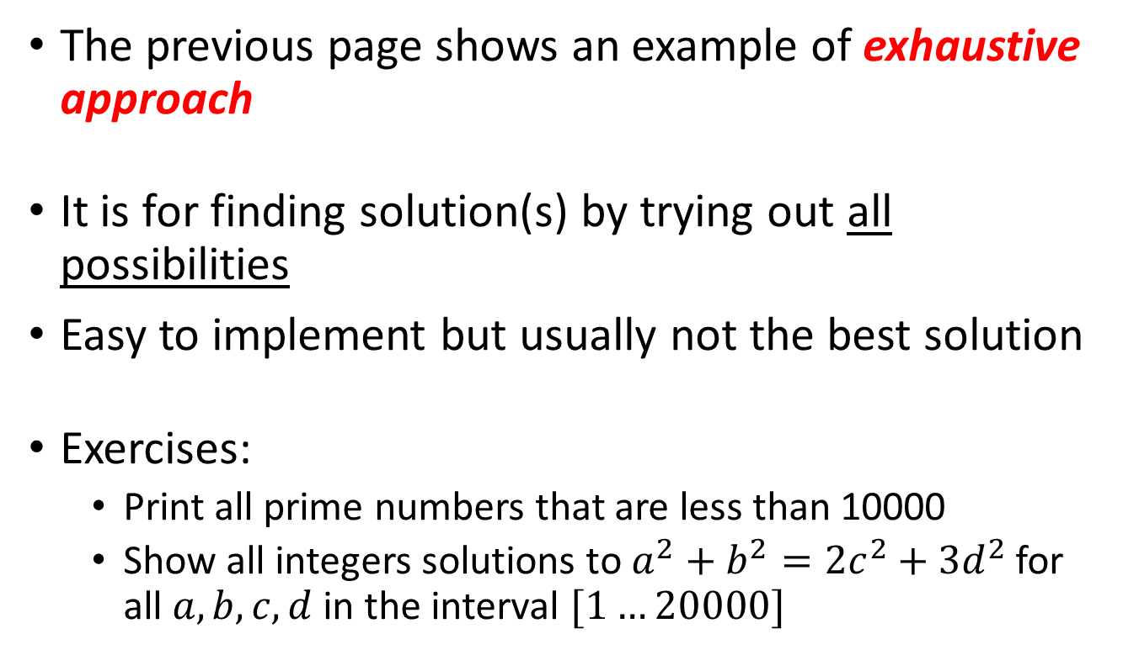
4.1 Exhaustive (Brute-Force) Approach
The previous page shows an example of exhaustive approach
It is for finding solution(s) by trying out all possibilities
Easy to implement but usually not the best solution
Exercises:
Print all prime numbers that are less than 10000
Show all integers solutions to $a^{2}+b^{2}=2c^{2}+3d^{2}$ for all $a,b,c,d$ in the interval $[1…20000]$

Slide 30
5.1 Controlling Loops with break
Usage of break:
Causes an immediate exit from the innermost enclosing loop
while (…) {
for (…;…;…) {
for (…;…;…) {
…
break;
…
}
stmt1;
break;
…
}
stmt2;
break;
…
}
stmt3;
Forces an immediate exit from the innermost for loop. Execution continues from stmt1
Forces an immediate exit from the middle for loop. Execution continues from stmt2
Forces an immediate exit from the while loop. Execution continues from stmt3

Slide 31
break: Example 1
1
2
3
4
5
6
7
8
9
10
int x;
while (true) {
cin >> x;
if (x <= 0)
break;
cout << "square = " << x * x << endl;
}
cout << "Bye!\n";
10↵
square = 100
16↵
square = 256
0↵
Bye!
Example 1:
A while loop that iterates until the input value is non-positive

Slide 32
break: Example 2
1
2
3
4
5
6
7
8
9
10
11
int i, x;
for (i = 0; i < 10; i++) {
cout << "i = " << i << " ";
cout << "x = ? ";
cin >> x;
if (x == 0)
break;
}
cout << "After the loop, i = " << i << endl;
Example 2:
A for loop that iterates ten times or stop when the input value is zero
i = 0 x = ? 10↵
i = 1 x = ? 20↵
i = 2 x = ? 0↵
After the loop, i = 2

Slide 33
5.2 Controlling Loops with continue
Usage of continue:
Causes the current iteration of the innermost enclosing loop to finish, and continues with the next iteration
while (condition) {
for (expr1; expr2; expr3) {
…
continue;
stmt1;
}
stmt2;
…
continue;
stmt3;
stmt4;
}
Skips the remaining statement (stmt1) in the for loop. Jumps to execute expr3 and then check expr2
Skips the remaining statements (stmt3 and stmt4) in the while loop. Jumps directly to check the loop condition of while

Slide 34
continue: Example
1
2
3
4
5
6
7
8
9
10
int data, sum = 0;
for (int k = 0; k < 5; k++) {
cin >> data;
if (data <= 0)
continue;
sum += data;
}
cout << "Sum of +ve values is " << sum << endl;
10↵
20↵
-1↵
90↵
-5↵
Sum of +ve values is 120
Example:
Read 5 inputs
Accumulate the input values only if they are positive

Slide 35
6. Selection: switch Statement
Syntax and Semantics:
Evaluate expression. The result must be an integral type (e.g., int, char)
Compare the result of expression with each constant_expr_i in order, until a matching is found
switch (expression) {
case constant_expr_1:
statement_1;
break;
case constant_expr_2:
statement_2;
break;
…
case constant_expr_n:
statement_n;
break;
default:
statement_d;
}
next_statement;

Slide 36
6. Selection: switch Statement
Syntax and Semantics:
Say, constant_expr_2 is matched
Execute:
statement_2,
statement_3,
…,
statement_n,
statement_d
However, whenever a break is reached, jump to next_statement immediately
switch (expression) {
case constant_expr_1:
statement_1;
break;
case constant_expr_2:
statement_2;
break;
…
case constant_expr_n:
statement_n;
break;
default:
statement_d;
}
next_statement;

Slide 37
6. Selection: switch Statement
Syntax and Semantics:
If none of constant_expr_i matches, and default is present, execute statement_d
Execute next_statement
switch (expression) {
case constant_expr_1:
statement_1;
break;
case constant_expr_2:
statement_2;
break;
…
case constant_expr_n:
statement_n;
break;
default:
statement_d;
}
next_statement;

Slide 38
1
2
3
4
5
6
7
8
9
10
11
12
13
14
15
16
17
18
19
20
21
int n;
cin >> n;
switch (n) {
case 1:
cout << "One\n";
break;
case 2:
cout << "Two\n";
break;
case 3:
cout << "Three\n";
break;
case 4:
cout << "Four\n";
break;
case 5:
cout << "Five\n";
break;
default:
cout << "Invalid number!\n";
}
2↵
Two
5↵
Five
10↵
Invalid number!

Slide 39
1
2
3
4
5
6
7
8
9
10
11
12
13
14
15
16
17
18
19
20
21
int n;
cin >> n;
switch (n) {
case 1:
cout << "One\n";
case 2:
cout << "Two\n";
case 3:
cout << "Three\n";
case 4:
cout << "Four\n";
break;
case 5:
cout << "Five\n";
default:
cout << "Invalid number!\n";
}
2↵
Two
Three
Four
5↵
Five
Invalid number!
10↵
Invalid number!

Slide 40
switch Statement: Exercise
When n is 1–5, print n “*” symbols
Otherwise, print “Not 1 to 5!”
Requirement: use cout << "*"; exactly five times
int n;
cout << "Enter the number of * to print: ";
cin >> n;
switch (n) {
… // Fill in something here
default:
cout << "Not 1 to 5!";
}

Slide 41
Summary
Know what is short-circuit evaluations
Understand do-while and for loops, and when should we use for loop
Know how to trace and write nested loops
Understand how break and continue works, especially in nested loops, and why overusing them is no good
Understand switch … case as a special multiway branching
Next: Fundamental Data Types

